Slide 1

ICT504 IT Strategy & Leadership Week 3 ICT Strategies and Concepts

Slide 2
Lecture Outline
ICT strategy.
Purpose of ICT strategy.
Strategy issues.
Planning strategy.
Problems and barriers with strategy.
Internal and external factors impacting strategy.
Tutorial Week 3
Attendance

Slide 3
ICT Strategy – What Is It?
Key Idea (Simplified) ICT Strategy is a long-term plan that helps organisations use tech smartly—not by changing systems, but by planning how to use ICT for better performance.

Slide 4
ICT Strategy – What Is It?
What it includes:
Long-term ICT planning.
Turning data into useful knowledge.
Making IT work with business goals.
Clear roles and responsibilities.
Supporting digital innovation.

Slide 5
ICT Strategy – What Is It?
Example (Australia): A university like UTS may create an ICT strategy to integrate online learning tools, ensuring staff and students get the best digital experience.
Remember: ICT Strategy = Planning, not immediate system change.

Slide 6
Why ICT Strategy Matters (Its Purpose)
Purpose in Simple Words:
Helps leaders make smarter decisions.
Makes sure the organisation gets full value from ICT.
Boosts tech skills across the workplace.
Aligns tech with company goals.

Slide 7
Why ICT Strategy Matters (Its Purpose)
Example (Australia): Woolworths uses ICT strategy to support delivery systems, self-checkout tech, and app-based services to match their business goals.

Slide 8
Strategic Issues ICT Solves
Common Issues ICT Strategy Helps Fix:
Issue | Explanation
Ad hoc IT use | Tech is used without planning.
Poor app integration | Systems don’t talk to each other.
Weak infrastructure | Slow networks, old software.
No ICT architecture | Each team uses their own thing with no standard.

Slide 9
Strategic Issues ICT Solves
Progress Path: Information → Transactions → Business → Collaboration
Example (Australia): NSW Health uses an ICT strategy to align data systems across hospitals for faster patient care.

Slide 10
Planning Steps for ICT Strategy
Define the Problem – Agree on what’s wrong.
Agree on Solution/Method – Choose how to fix it.
Identify People & Process – Know who’s involved.
Quantify Risks – What can go wrong?
Share the Plan – Make sure everyone understands.

Slide 11
Planning Steps for ICT Strategy
Example (Australia): Monash University planned its digital campus by defining access issues, then creating a shared online learning strategy.
Based on: https://tensix.com/the-5-step-planning-approach-that-works-every-time/

Slide 12
Strategy Formulation – What Are the Options?
Multiple Options to Explore:
Market Penetration – More users of current services.
Market Development – Expand to new users/places.
Product Development – Add new tools/services.
Governance – Set ICT policies.
System – Improve internal systems.
Infrastructure – Upgrade networks, storage, etc.
Security – Enhance cybersecurity.

Slide 13
Strategy Formulation – What Are the Options?
Example (Australia): Telstra upgraded its mobile services (product development + infrastructure) to improve customer experience.

Slide 14
5 Steps of Strategy Formulation (The Full Cycle)
Step | Action
1. Objectives | What does the organisation want?
2. Environment | Analyse market/tech trends.
3. Strategy | Choose what fits best.
4. Implementation | Put the plan into action.
5. Evaluation | Did it work? Make improvements.
Source: Marketing91 Strategy Guide

Slide 15
5 Steps of Strategy Formulation (The Full Cycle)
Example (Australia): MyGov services improved their online system through this cycle—identifying the need, testing ideas, and upgrading tech.

Slide 16
Research Discussion Questions
How can an ICT strategy help Australian businesses compete globally?
What challenges could arise if IT is not aligned with business goals?
What happens when an organisation skips strategy evaluation?

Slide 17
Hands-On Activities
Group Simulation:
You are the ICT team at a university. Create a basic ICT strategy to improve hybrid learning.
Include objectives, risks, and roles.
Australian Case Study Analysis:
Research how an Australian business (e.g., Coles, Qantas, Atlassian) uses ICT strategy.
Present a 3-slide summary in groups.

Slide 18
Hands-On Activities
Strategy Brainstorming:
Use post-it notes or Miro to map:
Problems
ICT options (from slide 5)
Risk levels

Slide 19
Hands-On Activities
Healthcare Sector
Remote Patient Monitoring
Problem: Patients in rural areas lack access to consistent healthcare.
ICT Options: IoT, Cloud, Mobile Apps.
Risk Levels: High privacy risk, medium operational risk.

Slide 20
Hands-On Activities
2. Electronic Health Records (EHR) Interoperability
Problem: Different hospitals use incompatible systems.
ICT Options: Cloud Computing, Blockchain.
Risk Levels: Medium privacy risk, high technical risk.

Slide 21
Hands-On Activities
3. AI-Powered Diagnostics
Problem: Delayed or misdiagnosed conditions.
ICT Options: AI, Big Data.
Risk Levels: High ethical risk, medium financial risk.

Slide 22
Hands-On Activities
Transportation Sector
Smart Traffic Management
Problem: Traffic congestion in urban areas.
ICT Options: IoT, Big Data Analytics.
Risk Levels: Low privacy risk, medium operational risk.

Slide 23
Hands-On Activities
2. Autonomous Vehicles
Problem: Human error in road accidents.
ICT Options: AI, IoT, Cloud.
Risk Levels: High ethical risk, high safety risk.

Slide 24
Hands-On Activities
3. Public Transport Contactless Payments
Problem: Inefficient and slow fare collection.
ICT Options: Mobile Tech, Blockchain.
Risk Levels: Medium financial risk, medium cybersecurity risk.

Slide 25
Hands-On Activities
Environmental Management
Smart Waste Management
Problem: Inefficient collection schedules.
ICT Options: IoT, Big Data.
Risk Levels: Low privacy risk, medium tech risk.

Slide 26
Hands-On Activities
2. Climate Data Monitoring
Problem: Inaccurate or delayed climate impact data.
ICT Options: Cloud, AI, Big Data.
Risk Levels: Medium data integrity risk, low privacy risk.

Slide 27
Hands-On Activities
Education
Adaptive Learning Platforms
Problem: One-size-fits-all teaching.
ICT Options: AI, Big Data, Mobile Tech.
Risk Levels: Medium ethical risk, high data privacy risk (student data).

Slide 28
Hands-On Activities
2. Online Exam Proctoring
Problem: Cheating in online assessments.
ICT Options: AI, Cloud, Mobile Tech.
Risk Levels: High ethical risk, medium user experience risk.

Slide 29
Hands-On Activities
Retail
Predictive Customer Analytics
Problem: Poor customer targeting and product suggestions.
ICT Options: Big Data, AI.
Risk Levels: Medium privacy risk, medium financial risk.

Slide 30
Hands-On Activities
2. Blockchain for Supply Chain Transparency
Problem: Counterfeit goods and lack of supply chain visibility.
ICT Options: Blockchain, IoT.
Risk Levels: Low privacy risk, medium operational risk.

Slide 31
Problem-Solving Task
Scenario: You work for a medium-sized hospital in Melbourne. Patient record systems are slow and different departments use different software.
Task:
Define the problem.
Identify planning steps.
Suggest three ICT strategy options.
Briefly draft a slide to “share the plan.”

Slide 32
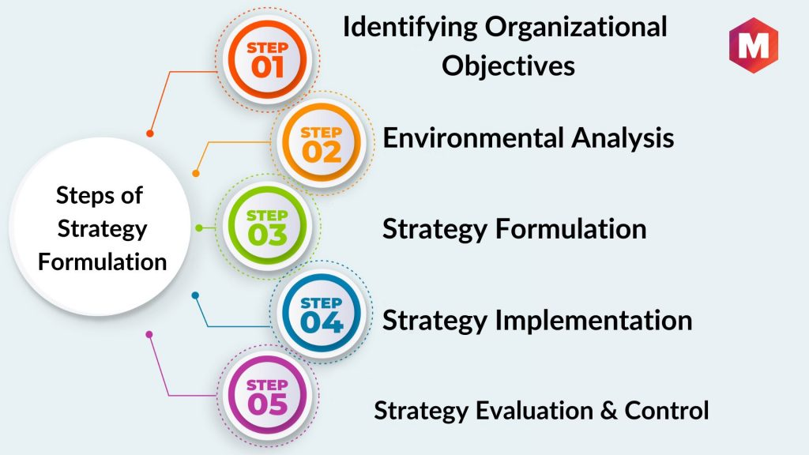
Strategy Formulation (Cont)
https://www.marketing91.com/10-steps-in-strategy-formulation/

Slide 33
Business Context for Managing Strategy
What’s the context?
Even the best ICT strategies can fail if the business side isn’t clear.

Slide 34
Business Context for Managing Strategy
Key Points:
Many staff don’t fully understand business goals.
Business goals often stay as ideas—no action plan.
Change needs to be managed well using ADKAR:
Awareness, Desire, Knowledge, Ability, Reinforcement
ROI (Return on Investment) matters: Are we getting value from ICT?

Slide 35
Business Context for Managing Strategy
Example (Australia): When Medibank adopted new IT systems, it used change management models to help employees adapt.

Slide 36
Effective Strategic Approach
What makes an ICT strategy strong?
It’s not just automation—it’s using tech wisely.
Tech should be embedded into how the business works.
Strategy must connect business needs, systems, and tech.

Slide 37
Effective Strategic Approach
Key Insight: Technology ≠ Strategy. The way you use tech = Strategy.
Example (Australia): Afterpay used a digital-first approach from the start, embedding ICT into its core business model.

Slide 38
Internal Business Factors
Why do businesses update strategy?
A new CEO or manager brings a new vision.
Budget cuts force smarter tech spending.
Company restructuring requires tech adjustments.
Launching new products/services needs new ICT support.

Slide 39
Internal Business Factors
Example (Australia): ABC News restructured to focus more on digital delivery, needing a new ICT plan for streaming and mobile apps.

Slide 40
Technology Factors
Tech changes = strategy changes. Why?
Factor | Impact
New tech | Creates new competition and chances.
New IT services | Push orgs to adopt or adapt.
Costs change | May need cheaper or more efficient tech.
Legacy systems | Can fail silently (e.g. airline bookings crashing).

Slide 41
Technology Factors
Example (Australia): Qantas updated its legacy systems after several major IT crashes.

Slide 42
Discussion Questions (Research-Based)
Why do many business strategies fail to become action plans?
How can ADKAR help with ICT change in large Australian organisations?
What happens when ICT strategy focuses only on automation and not on business integration?
What’s an example of a legacy system failure in Australia? What could have been done differently?

Slide 43
Hands-On Activities
ADKAR Model Roleplay Choose a real-life scenario (e.g. remote work setup at a university). Students play roles (IT, HR, end-users) and apply ADKAR to manage the change.
ROI Estimation Exercise Teams calculate ROI for a proposed system upgrade (e.g., upgrading laptops across a school). Include initial cost, expected benefits, and risks.

Slide 44
Hands-On Activities
Mini ICT Strategy Audit (Internal + Tech Factors) Pick an Australian company. Identify:
Internal changes (e.g. CEO, restructuring)
Tech changes (e.g. adopting AI or cloud)

Slide 45
Problem-Solving Task (Scenario-Based)
Scenario: You’re hired as an ICT consultant by a mid-sized logistics firm in Brisbane. Their tech is outdated, and the CEO just changed. They want a digital roadmap.

Slide 46
Problem-Solving Task (Scenario-Based)
Task:
Identify business and tech factors influencing strategy.
Use ADKAR to outline a change plan.
Draft a 3-slide presentation for leadership explaining:
What needs changing?
Why now?
What’s the ROI?

Slide 47
Assessment of Business Environment (Part 1)
What it means: Before building an ICT strategy, the organisation must understand where it stands now vs. where it wants to go.

Slide 48
Assessment of Business Environment (Part 1)
Compare Current vs. Future:
Element | Example in Australia
Technologies | From paper forms to online systems (e.g., MyGov)
Mission & Vision | E.g., RMIT wants to become a “smart campus”
Drivers for Change | COVID-19 pushed remote learning
Culture & Values | Are staff open to tech changes?
Performance Tracking | How is success measured currently?

Slide 49
Assessment of Business Environment (Part 2)
More areas to assess:
Strengths/Weaknesses – E.g., strong customer support but outdated systems
App Portfolio – Which software is in use? Are they effective?
Skills & Maturity – Do staff have the right ICT capabilities?
Vendors & Delivery – Who supplies ICT? Are they reliable?

Slide 50
Assessment of Business Environment (Part 2)
Example (Australia): TAFE NSW reviewed its ICT maturity and updated online systems for better student access.

Slide 51
Set Objectives for ICT Planning
Main Idea: Good planning = clear goals. These goals must support business agility and future-proof systems.
Key Objectives:
Be fast and adaptive to change (e.g., digital payments).
Secure and manage data properly.
Know what ICT work is internal vs. outsourced.
Understand team skills and plan for improvement.

Slide 52
Set Objectives for ICT Planning
Example: Woolworths developed its e-commerce system in-house but used third parties for delivery logistics.

Slide 53
Success Criteria
How do you know if the ICT strategy is working?
Track ICT project progress.
Measure usage, savings, and efficiency.
Get people involved and onboard.
Improve communication between teams.

Slide 54
Success Criteria
Example (Australia): My Health Record improved after better forecasting and user engagement.

Slide 55
Business Units Consolidation
What it means: Different departments need to work together—not in silos.
Key Concepts:
Share info and goals.
Align models for business + IT.
Standardise systems (less duplication).

Slide 56
Business Units Consolidation
Example (Australia): University of Sydney centralised its student and research systems into one portal.

Slide 57
Research Discussion Questions
What are some strengths and weaknesses in ICT delivery in public Australian services (e.g., Medicare, MyGov)?
Why is it important to assess organisational culture before implementing ICT strategy?
How do universities in Australia consolidate business and IT models? Find one example.

Slide 58
Hands-On Activities
Current vs. Future State Map Choose a real business or uni department. Students map:
Current tech, vision, values
Future goals and gaps

Slide 59
Hands-On Activities
Vendor & Delivery Evaluation Pick an ICT service provider in Australia (e.g., Telstra, Atlassian). Assess:
What do they offer?
Are they suitable for long-term collaboration?

Slide 60
Hands-On Activities
Set ICT Objectives Exercise In pairs, students choose a business scenario (e.g., online retail, aged care) and list:
3 strategic ICT objectives
Skills needed
Internal vs. external responsibilities

Slide 61
Problem-Solving Task (Scenario)
Scenario: You’re part of the ICT planning team at a healthcare startup in Melbourne. The CEO wants to digitise all patient records within 12 months. Staff are unsure about tech and vendors are expensive.

Slide 62
Problem-Solving Task (Scenario)
Your task:
Assess the current and future business environment.
Set clear ICT objectives (timeline, skills, responsibilities).
Identify at least 3 success criteria to measure progress.
Propose a way to unify internal units (admin, nurses, IT).

Slide 63
Strategic Input & Output Factors
What Is It?
Strategic Inputs are all the things an organisation must consider before making an ICT plan. Strategic Outputs are the results – like actual strategies and decisions based on those inputs.

Slide 64
Breakdown of Inputs and Outputs (Simplified Table)
Inputs | Outputs
External Business Environment (e.g. economy, social change, competition) | Business IS Strategy (How IT helps reach business goals)
Internal Business Environment (company goals, values, resources) | IT Strategy (Investments, suppliers, planning tech services)

Slide 65
Breakdown of Inputs and Outputs (Simplified Table)
Inputs | Outputs
External IT/IS Trends (emerging tech like AI, cloud, competitors' tech use) | IS/IT Management Strategy (Policies, governance to manage tech well)
Internal IT/IS Status (current tech systems, skills, maturity) | Part of IS/IT Management Strategy (Implementation plan and maturity mapping)

Slide 66
Strategic Input & Output Factors
🇦🇺 Australian Example:
Service NSW uses these inputs to improve digital services:
Looked at customer expectations (external)
Assessed staff tech skills (internal)
Followed digital trends (external IT)
Mapped current systems and gaps (internal IT) ➡ Then built outputs like digital licenses, mobile app upgrades, and online identity verification.

Slide 67
Research Discussion Questions
How do external pressures (like a pandemic or economy) shape ICT strategy in Australian organisations?
Why is assessing internal IT maturity important before launching a new system?
What happens if an organisation skips evaluating external digital trends?

Slide 68
Hands-On Activities
Mini Case Analysis: Choose an Australian business (e.g., Coles, ATO, or Canva). In pairs, fill out a 4-row version of the input-output table.
Trend Watch: Students research 3 current tech trends (e.g., AI in customer service, 5G, AR). Explain how these trends could influence an ICT output strategy for a retail business in Australia.

Slide 69
Hands-On Activities
Simulation: Build a Strategy Plan As a group, imagine you're the ICT team for a university.
Inputs: economic downturn, growing demand for online learning, low staff IT skills
Task: Create 3 strategic outputs (e.g., staff training plan, cloud strategy, LMS upgrade)

Slide 70
Summary
Overall approach to emphasises the continuous nature of process importance.
Using right people with correct competencies.
Setting objectives, goals and missions.

Slide 71

Reading Materials

Slide 72
Articles
E.M. Daniel, J.M. Ward and A. Franken, ‘A dynamic capabilities perspective of IS project portfolio management’, Journal of Strategic Information Systems, 23, 2014, 95–111.
E. Leidner, J. Lo, and D. Preston, ‘An empirical investigation of the relationship of IS strategy with firm performance’, Journal of Strategic Information Systems, 20, 4, 2011, 419–437; and D.E. Leidner, ‘The benefits of IS strategy and IS strategizing’, Cutter Benchmarking Review, 11, 2, 2011, 5–12.
D.Q. Chen, M. Mocker, D.S. Preston and A. Teubner, ‘Information systems strategy: Re-conceptualization, measurement and implications’, MIS Quarterly, 34, 2, 2010, 233–259.
J. Peppard and J. Thorp, ‘What every CEO should know and do about IT’, under review at California Management Review. See also J. Peppard, ‘Der Grosse Treiber’, Harvard Business Manager, January, 2015, 106–111.
G. Johnson, K. Scholes and R. Whittington, Exploring Corporate Strategy, Prentice-Hall, Englewood Cliffs, New Jersey, 2008.

Slide 73
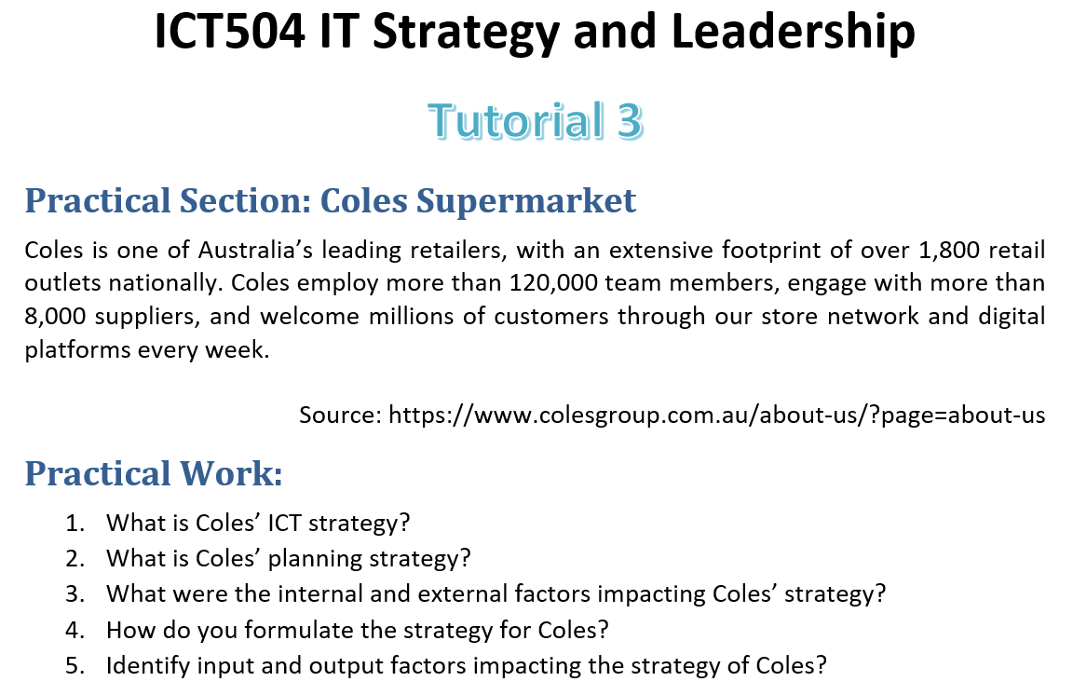
Tutorial Week 3

